Slide 1
Introduction to Arena
Dave Goldsman
Georgia Tech
Atlanta, GA, USA
sman@gatech.edu
www.isye.gatech.edu/~sman
(thanks to Seong-Hee Kim and Barry Nelson)
5/8/2017

Slide 2
Overview
We move to the design and analysis of dynamic systems that evolve over time.
We’ll use Arena, from Rockwell Software – one of several popular “discrete-event” simulation packages.
Free Arena download available at
https://www.arenasimulation.com/academic/students
5/8/2017

Slide 3
Some Definitions
A system is a collection of interacting entities (e.g., people, machines).
A model is an abstract representation of a system, describing the system in terms of states, entities, sets, events, etc.
The system state is a set of variables containing enough information to describe the system.
An entity is an object or component explicitly represented in the model. Can be permanent (e.g., machine) or temporary (e.g., customers).
Attributes are properties of entities (e.g., priority of a customer).
An event is a point in time at which the system state changes. E.g., an arriving customer finding the server busy.
The simulation clock is a variable whose value = simulated time.
5/8/2017

Slide 4
Modeling Approaches
There are two modeling approaches for the design and analysis of dynamic systems that evolve through time.
Event-Scheduling Approach. Concentrate on the events and how they affect the system state. We help the simulation evolve over time by keeping track of every event. This is a bookkeeping hassle. You might use this approach if you program in C++, Java, or FORTRAN.
Process-Interaction Approach. We use this approach. Concentrate on a generic customer (entity) and the sequence of events and activities it undergoes as it progresses through the system. At any time, the system may have many entities interacting with each other as they compete for resources. You do the generic customer modeling in this approach, but the computer simulation language (e.g., Arena) handles the event scheduling and bookkeeping. Saves lots of programming effort.
5/8/2017

Slide 5
How Does a Simulation Work?
Every simulation language maintains a future events list (FEL). This is the list of all activities' scheduled times of completion ― the list of all the events that we know about.
  The FEL is a set of events ordered by time.
  It can be updated any time an event occurs
  The simulation proceeds by…
    executing the next time-ordered event,
    updating the FEL (if necessary), and
    repeating
  Arena uses the P-I approach and transparently maintains the FEL (so you don’t have to).
5/8/2017

Slide 6
Arena World View
Arena takes the process-interaction world view.
Entities flow through a network of modules that describe their logical behavior.
We describe the network by developing a process flowchart.
5/8/2017

Slide 7
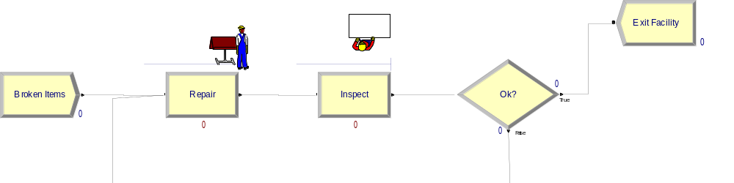
Flowchart Approach
5/8/2017

Slide 8
About modules…
Arena contains a very large number of modules that are organized into panels.
The panels are structured from high level to low level concepts:
  Basic Process
  Advanced Process & Advanced Transfer
  Blocks & Elements (a programming language)
Our goal is not to learn lots of modules, but rather to understand concepts that allow us to learn new modules as needed.
5/8/2017

Slide 9
Entities
Entities are dynamic elements that pass through the system.
Entities are distinguished by their attributes.
Ex: people, parts, information, paperwork, etc.
1: Kyle
2: Shepard
3: basketball
1: Chris
2: Caruso
3: baseball
5/8/2017

Slide 10
More on Entities
Entities must be Created to get them into the model, and are Disposed when they leave.
Unfortunately, attributes must be numerical values.
1: 948
2: 22.765
3: 0
5/8/2017

Slide 11
Queueing
Entities queue when they need processing.
In Arena…
  An entity tries to Seize a Resource.
  The time the entity uses the resource is the Delay.
  If the resource is not available, the entity waits in a Queue.
  The entity Releases the resource when processing is complete.
5/8/2017

Slide 12
Resources
Resources have…
  A Name (up to you)
  A Capacity (number of identical units of this resource; think # of servers).
  And can have a Schedule (how many available when).
And Resources can be animated.
5/8/2017

Slide 13
More on Resources
Resources are automatically defined by some modules (e.g., Process)
Resources can be defined manually, and the properties of all resources are changed, via the Resources spreadsheet on the Basic Process panel.
There is also a Schedule spreadsheet for specifying Resource schedules.
5/8/2017

Slide 14
More on Queues
Queues are created automatically by some modules (e.g., Process), and can be defined manually.
Properties of a queue, including the ranking rule, are defined via the Queue spreadsheet.
  First-in or Last-in first out
  Lowest or Highest attribute value first
5/8/2017

Slide 15
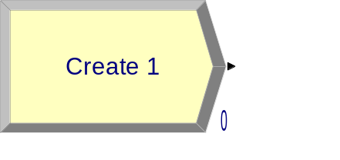
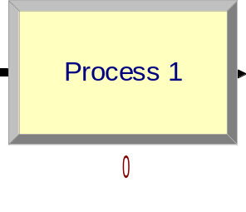
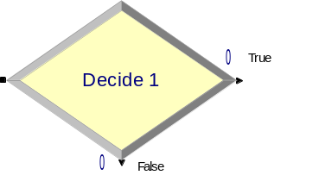
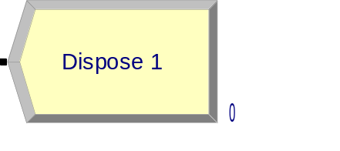
Basic Process Modules
 | Push (possibly) batches of entities into the model with a (possibly) random time between.
 | Models Queue-Seize-Delay-Release of Resource, or any part of this (like pure Delay).
 | Make decisions about where to go next based on conditions or chance.
 | Take entities out of the model and (perhaps) record statistics.
5/8/2017

Slide 16
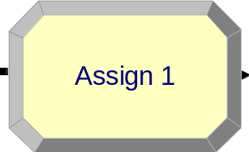
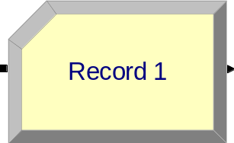
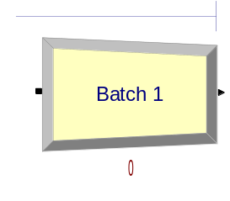
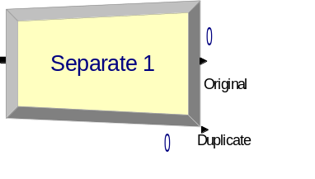
Basic Process Modules
 | Assign values (especially Attributes) when an entity passes through.
 | Record information when entities pass through, typically statistics on entities.
 | Combine multiple entities into a single entity.
 | Split multiple entities that were combined, or duplicate a single entity.
5/8/2017

Slide 17
Example
The decision is “2-way by chance” with 90% chance of being “true.”
Create item entities; note that “Random” time between means Exponential
The delay can be given by an expression, in this case Expo(0.125), exponential with mean 0.125.
Action is “Seize-Delay-Release” to represent a queue.
5/8/2017

Slide 18
Basic Animation
Entity movement (via module connections) and queues are automatically animated.
The entity movement does not correspond to the passage of simulated time.
Later we will learn how to animate transportation delays.
5/8/2017

Slide 19
Entity Animation
The Entity spreadsheet allows you to change the entity picture for each entity type.
The Entity Type is a name, usually given when the entity is created.
  Create: Entity Type: Items
An Assign module can be used to change the entity Type or Picture as it moves through the model.
5/8/2017

Slide 20
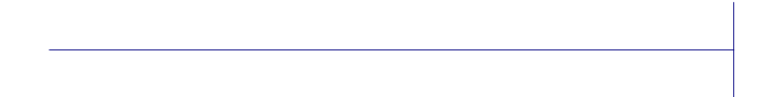
Queue Animation
The default queue is the sideways T.
The queue symbol can be dragged anywhere, or reoriented.
Often need to make the queue picture longer (which has no effect on queue capacity).
To lengthen the queue symbol, select it, grab the end, and pull.
5/8/2017

Slide 21
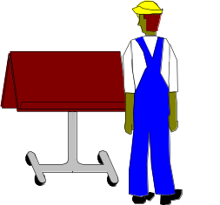
Resource Animation
Clicking the resource button lets you add a resource picture.
You select pictures for the Busy, Idle, Inactive and Failed states.
The Identifier must be the name of a resource already in the model (e.g., defined by a Process)
5/8/2017

Slide 22
Delays
Arena gives a default distribution for time between creations (“Random” = Expo) and delay (“Triangular”).
If we want to put in a different distribution, we select “Expression” and enter the appropriate Arena function, such as WEIB, POIS, etc.
We often get the expressions from the Input Analyzer.
5/8/2017

Slide 23
Seize-Delay-Release
Seize-Delay-Release need not be done in a single Process.
One Process may be used to Queue and Seize the resource, a number of other modules may represent the processing, and yet another Process may finally Release the resource.
5/8/2017

Slide 24
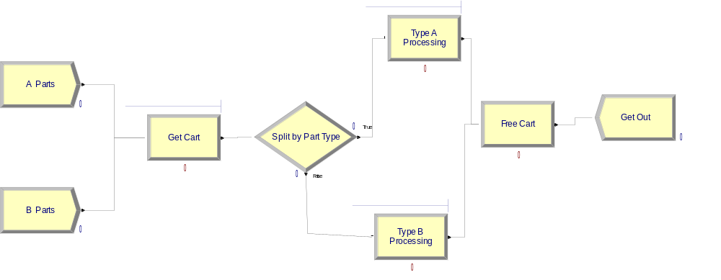
Example
Use a Seize-Delay (with delay 0) here to get a Cart resource
Use a Delay-Release (with delay 0) to free up the Cart resource
Each part type has a unique Process
Two different entity types are created
Use the entity type in 2-way by Condition decision.
5/8/2017

Slide 25
Internal Variables
Arena keeps a number of internal variables continually updated.
These variables are useful for making choices in a Decide module, displaying in animated plots, or for recording statistics.
The basic syntax is Name.Quantity
5/8/2017

Slide 26
Basic Process Variables
Create
Name.NumberOut
Process
Name.NumberIn
Name.NumberOut
Name.WIP
Name.WaitTime
Decide
Name.NumberOut True
Name.NumberOut False
Assign
Name.NumberOut
Batch
Name.NumberOut
Separate
Name.NumberOut Orig
Name.NumberOut Dup
Record
Name.NumberOut
Dispose
Name.NumberOut
5/8/2017

Slide 27
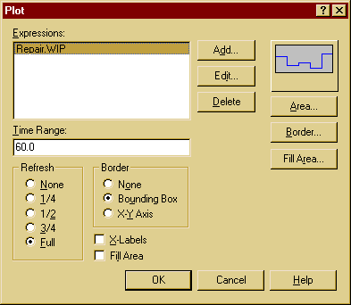
Example
We can use the internal variable Repair.WIP to create a dynamic plot of the number of parts at the Repair Process
5/8/2017

Slide 28
Simulated Time
The simulation keeps its own internal clock that jumps forward from event time to event time.
The time on the simulation clock is accessible through the Arena variable TNOW.
TNOW is useful for marking entities or making time-based decisions.
5/8/2017

Slide 29
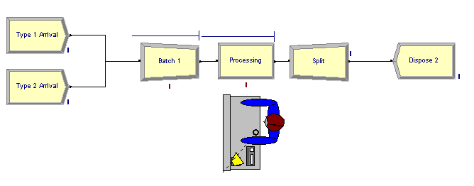
Batch and Split
Entities are processed in a batch of size two and then the system split entities that were combined.
5/8/2017

Slide 30
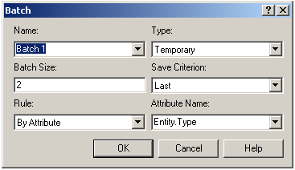
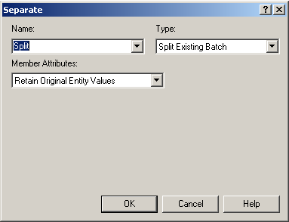
If one chooses “Permanent” as Type,
batched entities will never be split.
Separate module can
be used to generate
a duplicate of an entity.
An example will
be shown when we discuss
Advanced Input Modeling.
5/8/2017

Slide 31
Demos
Single-Server Queue
Multiple Arrival Streams
Call Center
Manufacturing Cell
Immunization Clinic
Pandemic Influenza Model
5/8/2017

